Slide 1

Summarizing Data
DMAIC – LSS14
Version: June 2026
Notes:
TIMING: 1.5 MINUTES
SPEAKER SCRIPT
Good morning, everyone, and welcome to Summarizing Data.
Today we'll take information about mistakes, which we call defects, and turn it into a few simple numbers that tell us how well a process is really working.
I promise this isn't math for the sake of math. Every number we cover today answers a practical question, like: how often do we get it right the first time? Where are the mistakes coming from? And how much hidden rework is eating up our time?
We'll use examples from the kind of work we do at the company: customer service, employment programs, and our support teams.

Slide 2


Virtual Classroom
Module
90 mins session.
Please mute your microphone if you are not speaking.
Q&A during the session in chat.
Define
Measure
Analyze
Improve
Control
Notes:
TIMING: 2 MINUTES
SPEAKER SCRIPT
A few quick ground rules. We've got 90 minutes. Please stay on mute when you're not talking, and use the chat anytime.
We'll mix short explanations, worked examples, and some hands-on activities. A calculator, or the one on your phone, will come in handy. But don't stress about the math. What matters most is understanding what each number tells you and what you'd do about it.
[CHAT] Quick check: type "ready" in the chat if you've got a calculator handy. [Pause.]

Slide 3
Measure Modules
5 modules you will study in Measure:
Define
Measure
Analyze
Improve
Control
LSS10 Data
LSS11 Data Measurement & Operational Definitions
LSS12 Data Verification
LSS13 Basic Statistics
LSS14 Summarizing Data
Notes:
TIMING: 1.5 MINUTES
SPEAKER SCRIPT
This is the last module in the Measure stage. The earlier modules covered how to define, check, and understand your data. Today we pull it all together.
We'll cover a handful of measures: defects, yield, defects per unit, opportunities, defects per million opportunities, process sigma, and rolled throughput yield. I know that's a mouthful. Don't worry. We'll take them one at a time, and each one just gives us a slightly different view of the same process.

Slide 4

Module Learning Outcomes
Summarizing Data – LSS14
By the end of this module, you will: Understand the meaning of defects and yield. Understand the meaning of process baseline and sigma. Be able to calculate defects and opportunities. Understand and be able to apply 'Final Yield' and 'Rolled Throughput Yield'.
Notes:
TIMING: 2 MINUTES
SPEAKER SCRIPT
By the end of today, you'll be able to explain defects and yield, describe a baseline and what "sigma" means, calculate defects and opportunities, and use two types of yield.
[CHAT] As we go, keep one real process in mind. Type it in the chat now. It could be participant intake, handling referrals, booking appointments, working with employers, or a support request. [Pause and read a few.]
Using your own process makes the math a lot easier to connect to real decisions.

Slide 5
01
Definition of Process Defects and Yields
Summarizing Data
Notes:
TIMING: 0.5 MINUTES
SPEAKER SCRIPT
Let's start with defects and yield. This section answers two simple questions: what counts as a mistake, and how often do we get it right the first time?
[ASK] Quick one: think of the last time you had to redo something at work because something was missing or wrong. Got it? Hold onto that. That's a defect.

Slide 6

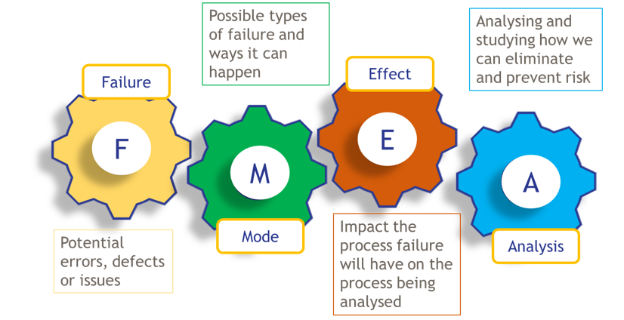
Definition - Defects
Effect
Failure
Impact the failure will have on the process being analyzed.
Defects are defined as:
Potential errors, defects or issues.
Outputs that do not meet expected results.
Customer requirements not achieved.
Variation or human error.
Waste or rework.
We measure defect risk using Failure Mode and Effect Analysis (FMEA) which we will explore in greater detail at various points in DMAIC.
F
M
E
A
Mode
Analysis
Possible types of failure and ways it can happen.
Analyzing and studying how we can eliminate and prevent risk.
Notes:
TIMING: 2.5 MINUTES
SPEAKER SCRIPT
[CLICKS ON THIS SLIDE: 5]
So what's a defect? It's anything that doesn't meet what was expected, or what the customer needed. That might be a mistake, missing information, a delay, rework, or a service we had to fix.
At the company, a defect could be a participant assessment that wasn't finished, an employer referral sent late, or wrong information that makes a customer call us back.
Now, there's a tool that helps us think ahead about defects, before they happen. It's called FMEA.
[CLICK → FMEA letters appear]
FMEA stands for Failure Mode and Effect Analysis. Let's break it down.
[CLICK → Failure]
Failure: what could go wrong?
[CLICK → Mode]
Mode: how could it go wrong?
[CLICK → Effect]
Effect: what would it do to the customer or the process?
[CLICK → Analysis]
Analysis: what can we do to prevent it or lower the risk?
The key point: a defect is a missed expectation. And defining it clearly is the first step to preventing it.

Slide 7
Example Defects
Missing Data
Customer record has no contact number.
Appointment notes not completed.
Mandatory fields in a form left blank.
Incorrect Input
Wrong customer details entered (e.g. name/date of birth).
Incorrect payment type selected.
Data entered in wrong format (e.g. date or Zip code).
Process Delays
Appointment not scheduled within target timeframe.
Approval not completed on time.
Request sits in queue with no action.
Quality Errors
Document contains spelling mistakes.
Incorrect information provided to customer.
Output does not meet agreed standard.
Incomplete
Task started but not finished.
Required documentation not uploaded.
Process skipped a required step.
Notes:
TIMING: 2 MINUTES
SPEAKER SCRIPT
[CLICKS ON THIS SLIDE: 5]
Defects come in a few common types.
[POLL] As I reveal each one, give a thumbs-up reaction if you've seen it happen on your team this month.
[CLICK → Missing Data]
Missing data: information we needed but didn't capture, like a participant record with no phone number.
[CLICK → Incorrect Input]
Wrong input: the info is there, but it's wrong or in the wrong format, like a mistake in an eligibility entry.
[CLICK → Process Delays]
Delays: if the customer needs it by a certain time, being late is a defect, like an appointment not booked within the target time.
[CLICK → Quality Errors]
Quality errors: work that doesn't meet the standard, like giving a job seeker the wrong guidance.
[CLICK → Incomplete]
Incomplete: a required step was skipped, like documents that never got uploaded.
[Pause and comment on the thumbs-up reactions.] The clearer we define each type, the more consistently different teams can spot and count them.

Slide 8
Definition – Final Yield
Final Yield is used to measure the performance of the process.
Definition: % of activities or outcomes completed correctly first time.
Formula:
Number of activities completed correctly
Total number of activities
Final Yield
Key Takeaway: If defects tell us what’s going wrong, final yield tells us how often we’re getting it right first time.
Notes:
TIMING: 2 MINUTES
SPEAKER SCRIPT
[CLICKS ON THIS SLIDE: 1]
Our first measure is Final Yield. It tells us how often work is done right the first time.
The math is simple: take the number done correctly, divide by the total. If 85 out of 100 are right the first time, your Final Yield is 85 percent.
At the company, that might be the percentage of participant records finished without any corrections, appointments booked correctly the first time, or employer referrals sent with all the required information.
A high yield means less rework and a smoother experience for the customer.
[CLICK → Key takeaway]
So if defects tell us what's going wrong, Final Yield tells us how often we're getting it right.

Slide 9

Example
Example:
A bakery produces 100 cakes in a day. Out of these, 85 units are good (no defects the first time). The other 15 were missing some icing or the cherry on the top.
Let’s apply a formula to work out how well the process is working to create cakes right first time.
Step 1 – Apply the formula: Final Yield = Good Cakes / Total cakes
Step 2 – Calculate: Yield = 85 / 100 = 0.85
Step 3 – Convert to percentage: Final Yield = 85%
Final Answer: The Final Yield is 85%, meaning 85% of were produced correctly the first time without rework.
Notes:
TIMING: 2 MINUTES
SPEAKER SCRIPT
[CLICKS ON THIS SLIDE: 1]
Let's try the formula with cakes.
A bakery makes 100 cakes, and 85 come out perfect the first time. Eighty-five divided by 100 is 0.85, or 85 percent.
[CLICK → Final answer]
So the Final Yield is 85 percent.
The same math works for our work. If 85 out of 100 participant assessments are done right with no fixes needed, the Final Yield is also 85 percent.
The important part is agreeing up front on what "right the first time" means. That's the operational definition from our last module.

Slide 10
Final Yield Limitations
Final yield tells us whether a unit is defective, but it does not show how many defects it contains. While we know some cakes did not meet the required standard, final yield alone cannot tell us the total number of defects.
Example:
Cake A → 1 defect (no icing)
Cake B → 4 defects (Too small, no icing, no sprinkles, no cherry)
In terms of final yield, both cakes are counted the same because both are defective. However, Cake B has more defects and is therefore a poorer-quality product. This is why Defects Per Unit (DPU) is an important measure.
Cake A
Cake B
Key Takeaway: Final yield is useful for a quick view, but to really understand and improve performance, we need to go deeper.
Notes:
TIMING: 2 MINUTES
SPEAKER SCRIPT
[CLICKS ON THIS SLIDE: 1]
Final Yield gives us a quick headline, but it has a blind spot. It treats every bad item the same.
Look at the two cakes. Cake A has one problem. Cake B has four. But Final Yield just says "both are bad."
[ASK] Does that seem fair? Is a cake with one issue really the same as a cake with four? [Pause for a couple of responses.]
Same thing happens with our work. One participant record might be missing one field. Another might be missing documents, have the wrong service code, and an overdue follow-up. Final Yield counts them both as one bad record and doesn't show the difference.
[CLICK → Key takeaway]
So Final Yield is great for a quick look, but to really understand what's going on, we need to dig deeper. That's where defects per unit comes in.

Slide 11
Final Yield to DPU Flow Example
Unit examples (item to be created or processed):
Cases created
HR requests
Payroll transactions
Leave requests
Benefits inquiries
Employee onboarding/offboarding actions
Units completed
Final
Yield
Defect Free
YES
Defect examples (things that have gone wrong):
Incorrect case update
Payroll processing error
Missing documentation
Wrong benefit enrollment
Completion timescale failure
Case reassignment
Employee/Customer call back required
NO
Final yield examples ( % Items completed first time)
Cases/requests completed correctly the first time
No rework required
No escalation required
Targets met
Final Yield = Right first time
Total number of items
How many defects?
Defects per unit (number of defects of total units)
DPU= Total defects
Total Units completed
DPU
Notes:
TIMING: 2 MINUTES
SPEAKER SCRIPT
This flow shows how the two measures fit together.
First, count everything that was completed. Then ask: is it mistake-free? If yes, it counts toward Final Yield. If no, count how many mistakes it has. That count gives us defects per unit, or DPU.
In plain terms: Final Yield asks, "Did we get it right the first time?" DPU asks, "When we didn't, how many things went wrong?"
Using both gives us a fuller picture of quality, and how much rework is hiding in the process.

Slide 12
Defects Per Unit (DPU)
Rather than simply classifying units as good or bad, DPU counts every defect.
DPU answers the question: “How many defects does each unit contain?”
Final Yield measures how many units are defect-free, while DPU measures the number of defects within those units.
Metric | What it Measures | Focus
Final Yield | % of defect-free units | Outcome (Good vs Bad)
DPU | Average defects per unit | Detail (How many defects)
Yield measures how often we get it right. DPU measures how many defects are present when we get it wrong.
Important: A single unit can have multiple defects.
Notes:
TIMING: 2 MINUTES
SPEAKER SCRIPT
[CLICKS ON THIS SLIDE: 4]
[CLICK → DPU explanation]
DPU goes beyond "good or bad." It counts every single mistake and tells us the average number of mistakes per item.
[CLICK → table]
Here's how that looks laid out.
[CLICK → Yield vs. DPU]
Yield tells us how often we get it right. DPU tells us how big the problem is when we don't.
[CLICK → "A single unit can have multiple defects"]
And remember, one item can have several mistakes. One participant file can have three problems. One support request can need four fixes.

Slide 13
DPU Formula
Below is the formula used for calculating the DPU for a cake making process. Figures are example only.
Total Number of Defects
Total Number of Units
DPU (defects per unit)
75
1000
0.075
Once we have our DPU, we can then use this Information to determine whether the process is performing or whether improvement is needed.
Notes:
TIMING: 2 MINUTES
SPEAKER SCRIPT
The DPU formula is simple: total mistakes divided by total items.
Here, 75 mistakes divided by 1,000 cakes equals 0.075 defects per unit.
[ASK] Quick gut check: does that mean every cake has a tiny piece of a mistake? [Pause.] No. It's just an average across the whole batch.
Once we know our DPU, we can watch whether mistakes are going up or down over time, and spot where we need to dig in.

Slide 14
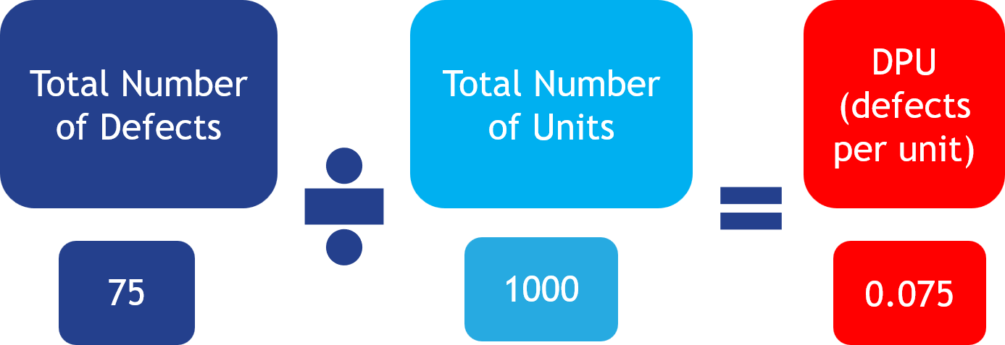
What does this tell us?
DPU is set internally so it varies according to each quality tolerance.
Using a scale is often easier to understand than using DPU numbers.
Having this scale allows us to identify when action needs to be taken.
DPU | Rating | Interpretation
<0.02 | Excellent | Highly capable process
0.02-0.05 | Good | Minor rework
0.05-0.10 | Within Tolerance | Some recurring defects
0.10-0.25 | Needs Improvement | Noticeable rework burden
0.25-0.50 | Poor | Significant quality issues
>0.50 | Critical | Systemic process problems
It is important to note that we can also set our own acceptable scale for defects per unit.
Notes:
TIMING: 2 MINUTES
SPEAKER SCRIPT
A DPU number by itself doesn't mean much without context. What's acceptable depends on the process, what the customer needs, and how risky a mistake would be.
This scale turns the number into categories that are easier to talk about. Our example of 0.075 lands in the "recurring" range.
But use some common sense. A small admin typo and a mistake that affects someone's eligibility shouldn't be treated the same. The scale helps you decide. It doesn't replace your judgment.

Slide 15

0: highly capable
0.02 – 0.05: Minor rework
0.10 – 0.25: Rework burden
0.05 – 0.10: Recurring
0.25 – 0.50: Significant issues
>50: Systemic Issues
What should we do about it?
DPU = 0.075 → Acceptable (Recurring)
What this means:
Defects are recurring and are not isolated incidents.
Action focus:
Identifying where defects recurring in the process before it becomes a bigger issue.
Fixing root causes at high-impact steps.
Reducing complexity and variation.
Preventing defects before they happen (not just fixing after).
Key Takeaway: At this level, the goal is not to fix individual defects. It is to fix the process.
Notes:
TIMING: 2 MINUTES
SPEAKER SCRIPT
[CLICKS ON THIS SLIDE: 1]
So what should we do about a DPU of 0.075?
At this level, mistakes keep coming back. They're not one-offs. So fixing individual cases won't solve it. We need to find where mistakes enter the process, figure out why, simplify things, and stop them from happening again.
At the company, that might mean fixing a standard template, clearing up a definition, adding a required field in the system, or bringing in our national experts to fix a pattern showing up across several projects.
[CLICK → Key takeaway]
At this level, the goal isn't to fix individual mistakes. It's to fix the process.

Slide 16
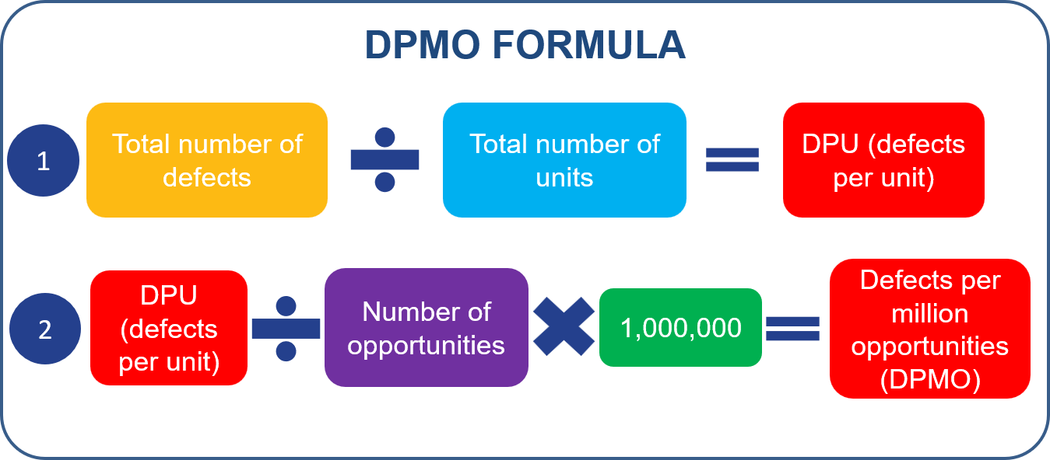
Calculating DPMO
Below are some other key terms you will need to know:
DPU (Defects per Unit): Measures defects per unit (e.g. appointment, service, product etc.).
Number of Opportunities: The number of chances for a defect to occur within ONE unit.
Defects per million opportunities (DPMO):
Uses DPU and opportunities to calculate (predict) defects per million units.
DPMO doesn't mean you need a million cases, referrals, applications, or employees. It's simply a standardized way of predicting defect rates so different processes can be compared.
Notes:
TIMING: 2 MINUTES
SPEAKER SCRIPT
Before we calculate DPMO, we need three terms.
DPU is defects per unit, which you know now. Opportunities are the number of chances for a mistake in one item. And DPMO, or defects per million opportunities, puts everything on the same scale so we can compare.
And here's the good news. You don't need a million cases. A million is just the standard yardstick, kind of like saying "miles per hour" when you're only driving for ten minutes.
The formula: DPU divided by opportunities per item, times one million. This lets us compare a simple process with a complicated one fairly.

Slide 17
Example: Opportunity Management
Opportunities are defined as the number of chances within a process for a defect to occur. The more components we have in our processes, the more opportunities there are for defects to occur.
Occupational Health Example
An Occupational Health referral has multiple opportunities for defects, including:
Referral information incomplete
Appointment scheduled incorrectly
Medical records incomplete
Return-to-work advice not communicated
By simplifying the referral process and using standard templates, the team can reduce process steps and handoffs.
Complex
Simplified
Referral
Referral
Example Improvements:
Referral review incorporated into booking.
Unnecessary approval removed.
Review
Booking
Approval
Assessment
Assessment
Report
Documentation
Communication
Communication
Key Takeaway: Reducing opportunities for defects is often achieved by removing unnecessary steps, approvals, and handoffs while retaining the activities that add value for the customer.
Notes:
TIMING: 2 MINUTES
SPEAKER SCRIPT
[CLICKS ON THIS SLIDE: 2]
An opportunity is any point in the process where a mistake could happen. The more steps a process has, the more chances there are for something to go wrong.
[CLICK → Occupational health example]
In this referral example, the referral info could be incomplete, the appointment could be booked wrong, records could be missing, or the return-to-work advice might not get shared. That's four opportunities.
Look at the two processes on the slide. The simpler one removed an unnecessary approval and combined the review with booking. Fewer steps means fewer chances for mistakes.
At the company, our systems can help too, with required fields, automatic routing, and standard templates.
[CLICK → Key takeaway]
The goal isn't to cut steps that help the customer. It's to cut the extra complexity that creates chances for mistakes.

Slide 18
How to Determine Opportunities
When working out the number of opportunities for defects, you need to ensure consistency.
1. | Identify defects: Prepare an initial list of possible defect types.
2. | Categorize defects: Actual defects – physical faults (e.g., cracks, damage). Customer-critical defects – impact customer satisfaction. Process-specific defects – related to how the process operates.
3. | Focus on routine defects: Exclude one-off or non-routine issues.
4. | Group similar defects: Combine related defects together.
5. | Apply a consistent definition: Opportunities should reflect where defects can occur, not every possible failure scenario.
6. | Validate against standards: Cross-check opportunities with specifications and tolerances.
8. | Maintain consistency: Avoid changing definitions once measurement begins.
Notes:
TIMING: 2.5 MINUTES
SPEAKER SCRIPT
When you count opportunities, be consistent.
Start with the common mistakes that matter to the customer or the process. Group similar ones together, match them to where they can happen, and double-check your list against your standards.
Don't try to list every possible thing that could ever go wrong. Keep it practical.
And once you start measuring, don't change the definition without writing it down. Otherwise you can't compare this month to last month, or one project to another.
[ASK] Why do you think someone might be tempted to add more opportunities? [Pause.] Right: more opportunities makes the score look better. We'll see that in an example shortly.

Slide 19
Opportunities and DPMO Summary
Identify defect opportunities per item
Scenario:
A bakery produces 100 cakes.
Each cake has 3 defect opportunities:
Sponge baked correctly
Icing applied correctly
Decoration added (e.g. cherry)
Calculate the total opportunities (what could go wrong)
100 cakes x 3 opportunities
Calculate DPU (what did go wrong)
3 defects/100 cakes = 0.03 defects per cake
Apply DPMO
DPMO = (DPU ÷ Opportunities) × 1,000,000
= (0.03 ÷ 3) × 1,000,000
= 10,000 cake defects per million opportunities
Notes:
TIMING: 2.5 MINUTES
SPEAKER SCRIPT
Let's put it all together with our cakes.
One hundred cakes, each with three chances for a mistake: the sponge, the icing, and the decoration. That's 300 total opportunities.
We found 3 mistakes across 100 cakes. That's a DPU of 0.03.
Now divide 0.03 by 3 opportunities and multiply by one million. That gives us 10,000 DPMO.
Here's a simple way to remember it: opportunities are what could go wrong. DPU is what did go wrong. DPMO puts it on a common scale.

Slide 20
Real Work Example: Occupational Health
Scenario: Occupational Health Referrals
A team manages 100 occupational health referrals.
Each referral has defect opportunities:
Employee assessment booked correctly
Medical information recorded correctly
Return-to-work recommendation communicated correctly
Assume: 3 defects found across the 100 referrals.
Examples of Defects:
Incorrect appointment scheduling
Missing medical documentation
Return-to-work guidance not communicated
Identify defect opportunities per item
Calculate the total opportunities (what could go wrong)
100 referrals X 3 opportunities = 300 opportunities
Calculate DPU
(what did go wrong)
3 defects/100 referrals = 0.03 defects per item
Apply DPMO
DPMO = (DPU ÷ Opportunities) × 1,000,000
= (0.03 ÷ 3 Defects) × 1,000,000
= 10,000 defects per million opportunities
Notes:
TIMING: 1.5 MINUTES
SPEAKER SCRIPT
Now the same math with occupational health referrals.
One hundred referrals, each with three opportunities, gives 300 total opportunities.
Three mistakes divided by 100 referrals is a DPU of 0.03. Divide by 3 and multiply by a million, and we get 10,000 DPMO.
Same math as the cakes. But a mistake within a project often affects a real person getting back to work, so how we define and prioritize mistakes has to fit the service.

Slide 21
Real Work Example: Employability Support
Scenario: Employability Support
The Employability Team supports 250 job seekers each month.
Each job seeker has 4 defect opportunities:
Initial assessment completed
Action plan created
Training assignment completed
Employer referral submitted
During the month, the team identifies 12 defects:
4 x assessments not completed
3 x action plans delayed
2 x incorrect training assignments
3 x employer referrals missed
Identify defect opportunities per item
Calculate the total opportunities (what could go wrong)
250 referrals x 4 opportunities = 1000 opportunities
Calculate DPU (what did go wrong)
12 defects/250 referrals = 0.048 defects per item
Apply DPMO
DPMO = (DPU ÷ Opportunities) × 1,000,000
= (0.048 ÷ 4 Defects) × 1,000,000
= 12,000 defects per million opportunities
Notes:
TIMING: 1.5 MINUTES
SPEAKER SCRIPT
This one's very close to home for us: employment support.
Two hundred fifty job seekers, each with four opportunities, gives 1,000 total opportunities. Twelve mistakes divided by 250 is a DPU of 0.048. Divide by 4 and multiply by a million: 12,000 DPMO.
[ASK] Looking at the list of mistakes on the slide, which one would you go after first? [Take one or two answers.]
That's the real value here. The mistake types tell us where to look: assessments, action plans, training assignments, or employer referrals. The number becomes something we can act on.

Slide 22
Real Work Example: People and Culture
Scenario: HR Onboarding
The People and Culture team onboarded 300 new starters this quarter.
Each starter has 5 defect opportunities:
Right to work verified
Payroll setup completed
System access provisioned
Manager induction completed
Mandatory training assigned
Assume 20 of these defects identified across the
300 starters.
Missing contract
Payroll setup errors
Delayed laptop request
Incorrect manager allocation
Mandatory training not assigned
Identify defect opportunities per item
Calculate the total opportunities (what could go wrong)
300 new starters x 5 opportunities = 1500 opportunities
Calculate DPU (what did go wrong)
20 defects/300 new starters = 0.0667 defects per item
Apply DPMO
DPMO = (DPU ÷ Opportunities) × 1,000,000
= (0.0667÷ 5 Defects) × 1,000,000
= 13, 333 items defects per million opportunities
Notes:
TIMING: 1.5 MINUTES
SPEAKER SCRIPT
One more: onboarding new employees.
Three hundred new starters, each with five opportunities, gives 1,500 total opportunities. Twenty mistakes divided by 300 is about 0.0667. Divide by 5 and multiply by a million: about 13,333 DPMO.
This lets us compare over time. But we still need to look at the types of mistakes. A payroll error, a late laptop, and missing training each need a different fix.

Slide 23
Activity:
Scenario: Child Care Eligibility
Child Care supported 200 families during the month.
Each family has 4 opportunities for a defect to occur:
Eligibility completed
Income calculation
Evidence verification
Child Care Notice
During the month, the team identified 16 defects:
5 x eligibility not completed
4 x income calculations incorrect
3 x incorrect evidence approved
4 x Child Care notices not issued to provider
Identify defect opportunities per item
Calculate the total opportunities (what could go wrong)
# Families x # opportunities = # opportunities
Calculate DPU(what did go wrong)
# defects/# families = # defects per unit (item)
Apply DPMO
DPMO = (DPU ÷ Opportunities) × 1,000,000
= (DPU÷ # Defects) × 1,000,000
= # Child Care defects per million opportunities
Notes:
TIMING: 2.5 MINUTES
SPEAKER SCRIPT
Now it's your turn!
Our child care team supported 200 families. Each family has 4 chances for a mistake, and the team found 16 mistakes.
Work through three steps: total opportunities, then DPU, then DPMO. Use the formula on the slide.
[CHAT – waterfall] Type your DPMO answer in the chat, but don't hit enter until I say go. I'll give you about two minutes. [Pause for the activity, then say "Go!" and look at the spread of answers.]

Slide 24
Activity: Answer
Scenario: Child Care Eligibility
Child Care supported 200 families during the month.
Each family has 4 opportunities for a defect to occur:
Eligibility completed
Income calculation
Evidence verification
Child Care Notice
During the month, the team identified 16 defects:
5 x eligibility not completed
4 x income calculations incorrect
3 x incorrect evidence approved
4 x Child Care notices not issued to provider
Identify defect opportunities per item
Calculate the total opportunities (what could go wrong)
200 new starters x 4 opportunities = 800 opportunities
Calculate DPU (what did go wrong)
16 defects/200 families = 0.08 defects per item
Apply DPMO
DPMO = (DPU ÷ Opportunities) × 1,000,000
= (0.08÷ 4 Defects) × 1,000,000
= 20,000 Child Care defects per million opportunities
Notes:
TIMING: 1.5 MINUTES
SPEAKER SCRIPT
Let's check.
Four opportunities times 200 families gives 800 total opportunities. Sixteen mistakes divided by 200 families gives a DPU of 0.08. Then divide 0.08 by 4 opportunities and multiply by one million. The answer is 20,000 DPMO.
[ASK] Who got 20,000? Give me a thumbs-up! [Pause.]
One tip: in the DPMO step, divide by the opportunities per family, which is 4, not the total of 800. DPU already accounts for the number of families.

Slide 25
02
Calculating Process Sigma
Summarizing Data
Notes:
TIMING: 0.5 MINUTES
SPEAKER SCRIPT
We've worked out how many mistakes a process makes. Next, we'll turn that into one score called Process Sigma. It's another way to describe how good a process is.

Slide 26

Process Sigma (σ) Definition
Process Sigma is a measure of how well a process performs by assessing the amount of variation and the number of defects produced.
It indicates how capable a process is of consistently meeting customer requirements.
A higher Sigma level means:
Fewer defects
Less variation
More consistent results
Better process performance
Notes:
TIMING: 2 MINUTES
SPEAKER SCRIPT
Process Sigma is a score for how well a process performs, based on its mistakes and how much it varies.
The higher the sigma, the better: fewer mistakes, less variation, more consistent results.
For the company, sigma gives everyone a shared way to talk about whether a process consistently meets customer needs.
Just remember, sigma isn't the improvement itself. It's a scorecard. It helps us set a starting point, compare results, and see whether our changes are working.

Slide 27
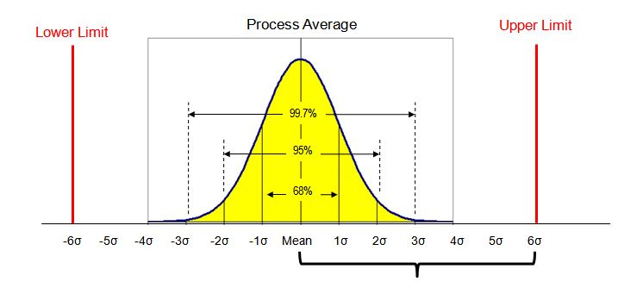
Capturing Baselines Using Process Sigma
Process Sigma focuses on ‘output performance’ and ‘defects’ produced by the process.
How the process performs most of the time.
Capturing a sigma baseline helps us measure how well a process is performing. It can be represented in graph format.
It helps us understand:
How consistently the process meets customer requirements.
How much variation exists in the process.
How many defects are being produced.
Where improvement opportunities exist.
Whether changes made to the process are improving performance.
Sigma measures how much variation exists around the process average.
Notes:
TIMING: 2 MINUTES
SPEAKER SCRIPT
A sigma baseline is a snapshot of how a process is performing today. It shows what normal looks like, how much things vary, how many mistakes we make, and where we could improve.
Look at the chart. Two processes can have the same average but very different amounts of variation. One is steady. The other is all over the place.
After you make a change, you compare to this baseline. That tells you if things really got better, instead of just having one lucky week.

Slide 28
Examples of Sigma Impact
These defects represent examples of customer-impacting errors that Process Sigma can measure.
Employment Services
Job seeker assessment not completed.
Incorrect training or support program assigned.
Employer referral not submitted on time.
Housing
Services
Supporting evidence missing or incomplete.
Housing application assessed incorrectly.
Housing decision not communicated within target timescales.
Occupational
Health
Occupational health appointment scheduled incorrectly.
Medical information missing or recorded inaccurately.
Return-to-work recommendations not communicated to the manager.
Child Care
Services
Child placement information recorded incorrectly.
Required safeguarding documentation missing.
Care plan review not completed on time.
Shared
Services
Employee case routed to the wrong team.
Employee request not resolved within service level timescale.
Employee record updated incorrectly.
Each of these defects moves us further away from the perfect process.
Notes:
TIMING: 2 MINUTES
SPEAKER SCRIPT
Here are examples of mistakes that affect customers across different services.
In employment services, an unfinished assessment, the wrong training assignment, or a late employer referral can slow down a job seeker's progress. In shared services, sending a request to the wrong team or updating a record incorrectly creates rework for local teams.
[CHAT] Which of these sounds most familiar to you? Type the service name. [Pause and react.]
Tracking these gives us a baseline and helps point improvement support to the right place. Just be careful not to compare very different services head to head. Use the same method within each process and watch whether quality improves.

Slide 29
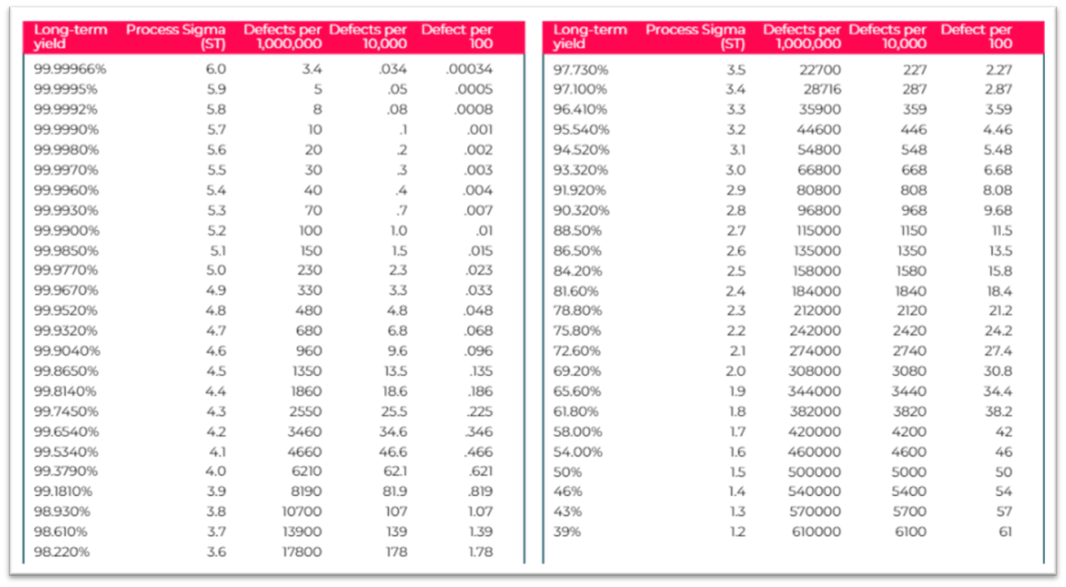
Process Sigma Table
The sigma table below is used to convert DPMO data into Sigma Value:
Example Sigma Value conversion:
Number of units: 100
Opportunities per unit: 5
Total number of defects: 7
DPU = 7/100 = 0.07
DPMO = 0.07/5 X 1,000,000 = 14000
Process Sigma ≈ 3.7 (from table)
*Always go to the nearest DPMO
Lower DPMO = Higher Sigma = Better quality
Notes:
TIMING: 2.5 MINUTES
SPEAKER SCRIPT
To turn DPMO into a sigma score, find the closest DPMO number in the table and read across to the sigma level.
In this example: 7 mistakes across 100 items gives a DPU of 0.07. Divide by 5 opportunities and multiply by a million: 14,000 DPMO. The closest match in the table is about 3.7 sigma.
Remember which way it goes: lower DPMO means higher sigma, and higher sigma means better quality. Kind of like golf. The lower your mistake count, the better you're doing.

Slide 30
Activity – calculate Sigma value
Using the table below and the data provided, calculate the value for the following processes:
Number of units: 800
Number of opportunities: 20
Total number of defects: 12
DPU:
DPMO:
Process Sigma:
Number of units: 150
Number of opportunities: 7
Total number of defects 10
DPU:
DPMO:
Process Sigma:
Number of units: 75
Number of opportunities: 9
Total number of defects 7
DPU:
DPMO:
Process Sigma:
Reminder: Always go to the nearest DPMO.
Notes:
TIMING: 3 MINUTES
SPEAKER SCRIPT
Your turn again. Work through these three on your own or with a partner.
For each one: first get the DPU, then divide by the opportunities and multiply by a million to get DPMO, then find the closest sigma in the table.
[CHAT] Post your three sigma answers in the chat when you're done. I'll give you a few minutes. [Pause for the activity and check answers as they come in.]

Slide 31
Activity – solutions
Number of units: 800
Number of opportunities: 20
Total number of defects:12
DPU: 12/800 = 0.015
DPMO: 0.015/20 x 1,000,000 = 750
Process Sigma: 4.7
Number of units: 150
Number of opportunities: 7
Total number of defects: 10
DPU: 10/150 – 0.066
DPMO: 0.066/7 x 1,000,000 = 9,524
Process Sigma: 3.8
Number of units: 75
Number of opportunities: 9
Total number of defects: 7
DPU: 7/75 = 0.093
DPMO: 0.093/9 x 1,000,000 =
10,370
Process Sigma: 3.8
Notes:
TIMING: 2 MINUTES
SPEAKER SCRIPT
[CLICKS ON THIS SLIDE: 3]
Let's check your answers.
[CLICK → first answer]
First process: 12 divided by 800 is a DPU of 0.015. Divide by 20 and multiply by a million: 750 DPMO. That's about 4.7 sigma.
[CLICK → second answer]
Second process: 10 divided by 150 is about 0.0667. Divide by 7 and multiply by a million: about 9,524 DPMO. That's about 3.8 to 3.9 sigma.
[Note: You may have 9,428 and 4.0 because of rounding too early. The more accurate answer is about 9,524 DPMO and about 3.8 to 3.9 sigma.]
[CLICK → third answer]
Third process: 7 divided by 75 is about 0.0933. Divide by 9 and multiply by a million: about 10,370 DPMO. That's about 3.8 sigma.
A quick tip: small differences usually come from rounding too early. Keep the extra decimals until the very end.

Slide 32
3
Exploring Opportunities for Improvement
Summarizing Data
Notes:
TIMING: 0.5 MINUTES
SPEAKER SCRIPT
[CLICKS ON THIS SLIDE: 1]
[CLICK → section title appears]
Now let's use these measures to find ways to improve. The question changes from "What's our score?" to "What is the score telling us to look into?"

Slide 33
Activity - Opportunity for Improvement
The business has recently launched an employee information pack and has arranged for printing with its new supplier.
Our Communications Team sampled 100 updated information packs and found 5 defects.
These included:
Spelling errors
Incorrect color palette
Missing content
Image distortion
Missing staples
DPU: Defects per unit (DPU) was 0.05 (5/100)
DPMO: DPU/Opportunities x by 1,000,000 = 1,250
Opportunities
Each information pack has:
20 Pages
15 high resolution images
5 printing & finishing process steps
= 40 opportunities for defect
Using the table - what is the Sigma now?
Using the table - what is the Sigma?
Notes:
TIMING: 2 MINUTES
SPEAKER SCRIPT
[CLICKS ON THIS SLIDE: 4]
Here's the scenario. The company just launched an employee information pack and is printing it with a new supplier.
[CLICK → sample results]
Our Communications team checked 100 packs and found 5 mistakes, like spelling errors, wrong colors, missing content, blurry images, and missing staples. That's a DPU of 0.05.
[CLICK → "Using the table, what is the sigma?"]
First, using the table, what's the sigma if we only look at the mistakes per pack, without opportunities? [Pause for answers.]
[CLICK → Opportunities]
Now, each pack has 40 chances for a mistake: 20 pages, 15 images, and 5 printing steps. So DPU of 0.05, divided by 40, times a million gives 1,250 DPMO.
[CLICK → "What is the sigma now?"]
Using the table, what's the sigma now? [Pause for calculation and chat answers.]

Slide 34
Activity - Opportunity for Improvement
The business has recently launched an employee information pack and has arranged for printing with its new supplier.
Our Communications Team sampled 100 updated information packs and found 5 defects.
These included:
Spelling errors
Incorrect color palette
Missing content
Image distortion
Missing staples
DPU: Defects per unit (DPU) was 0.05 (5/100)
DPMO: DPU/Opportunities x 1,000,000 = 1,250
Opportunities
Each information pack has:
20 pages
15 high resolution images
5 printing & finishing process steps
= 40 opportunities for defect
Sigma based on DPU and no opportunities = 3.1 –3.2
Sigma based on DPMO = 4.5-4.6
Notes:
TIMING: 2 MINUTES
SPEAKER SCRIPT
[CLICKS ON THIS SLIDE: 2]
Let's look at the answers.
If we only look at mistakes per pack, without opportunities, the sigma is about 3.1.
[CLICK → Sigma based on DPMO]
When we include the 40 opportunities, the DPMO of 1,250 gives a sigma of about 4.5 to 4.6.
[CLICK → sample details]
Why the big jump? Because opportunities account for how complicated the product is. A 20-page pack with lots of images has way more chances for mistakes than a one-page flyer.
But here's the catch. Opportunities have to be defined the same way every time. You can't just add more to make your score look better.

Slide 35
Let’s check the table
1
Based on just defects per 100. You can see there were 5 defects. Giving the process a:
95% yield
Sigma of 3.1 – 3.2
2
Including opportunities for defects per million (DPMO)
DPMO sits between 4.5 – 4.6
Notes:
TIMING: 2 MINUTES
SPEAKER SCRIPT
[CLICKS ON THIS SLIDE: 2]
Let's confirm on the table.
[CLICK → marker 1]
Looking only at mistakes per pack: 95 percent yield, which is about 3.1 sigma.
[CLICK → marker 2]
Including opportunities: 1,250 DPMO, which is about 4.5 to 4.6 sigma.
These two numbers answer different questions. Yield tells us how many packs were mistake-free. DPMO tells us how many mistakes there were compared to all the chances for a mistake. When you share a result, always say which one you're using, so people know what they're looking at.

Slide 36
Activity - opportunities for improvement
Our communications team have decided to redesign the existing pack and design a second version before releasing it to the teams.
Our Communications Team sampled 100 updated information packs and found 3 defects.
These included:
Spelling errors
Missing content
Incorrect numbering
DPU: Defects per unit (DPU) was 0.03 (3/100)
DPMO: DPU/Opportunities x 1,000,000 = 0.03/78 x 1,000,000 = 384.6 (385)
Opportunities
Each information pack has:
45 pages
25 high resolution images
8 printing and finishing process steps
78 = opportunities for defect
Process sigma based on DPU and no opportunities
= 3.3–3.4
Using the table, what is the new sigma score?
Notes:
TIMING: 3 MINUTES
SPEAKER SCRIPT
[CLICKS ON THIS SLIDE: 1]
Now the Communications team redesigns the pack and makes a second version.
They check 100 new packs and find 3 mistakes. That's a DPU of 0.03. Without opportunities, the sigma is about 3.3 to 3.4.
[CLICK → new opportunities]
But the new pack is bigger: 45 pages, 25 images, and 8 printing steps. That's 78 opportunities. So 0.03 divided by 78, times a million, is about 385 DPMO.
[CHAT] Using the table, what's the new sigma? Type it in. [Pause for calculation.]
While you work, think about this: did the redesign really cut down on mistakes the customer would notice? Or did it just add more opportunities?

Slide 37
Activity- Answer
Our Communications Team sampled 100 updated information packs and found 3 defects.
These included:
Spelling errors
Missing content
Incorrect numbering
DPU: Defects per unit (DPU) was 0.03 (3/100)
DPMO: DPU/Opportunities x 1,000,000 = 0.03/78 x 1,000,000 = 384.6 (385)
Opportunities
Each information pack has:
45 Pages
25 high resolution images
8 printing and finishing process steps
78 = opportunities for defect
Sigma based on DPU and no opportunities = 3.3–3.4
Sigma with opportunities 4.8 - 4.9
Notes:
TIMING: 2 MINUTES
SPEAKER SCRIPT
[CLICKS ON THIS SLIDE: 1]
[CLICK → answer]
With opportunities included, the answer is about 4.8 to 4.9 sigma. Looking only at mistakes per pack, it's about 3.3 to 3.4.
Here's how we got there: 0.03 divided by 78, times a million, is about 385 DPMO.
The big lesson: always calculate using the same definitions, and keep your decimals until the last step.

Slide 38
Let’s check the table
1
Based on defects per 100. You can see there were 3 defects.
Giving the process a:
97% yield
Sigma of 3.3–3.4
2
Including opportunities for defects per million (DPMO).
DPMO of 385 sits between 4.8-4.9
Notes:
TIMING: 2 MINUTES
SPEAKER SCRIPT
[CLICKS ON THIS SLIDE: 2]
Let's confirm it on the table.
[CLICK → marker 1]
Looking only at mistakes per pack: 3 mistakes out of 100 gives a 97 percent yield, or about 3.3 to 3.4 sigma. [Note: the slide says "5 defects". It should say 3.]
[CLICK → marker 2]
Including opportunities: 385 DPMO, which is about 4.8 to 4.9 sigma. [Note: the slide says "DPMO of 1250". It should say 385.]

Slide 39
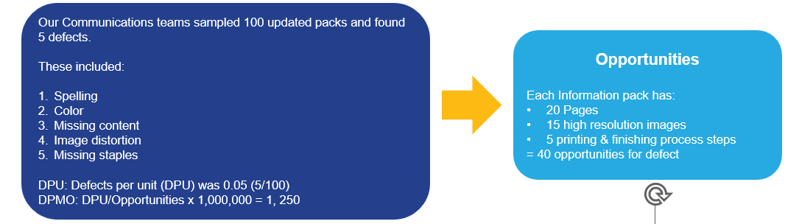
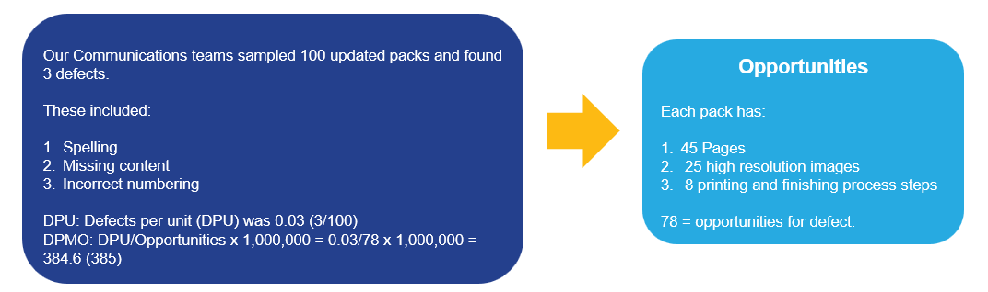
Which Information Pack format is better?
Info pack Version 1
Info Pack Version 2
Our Marcoms teams sampled 100 packs and found :
1250 = 4.5 - 4.6 Sigma
385 = 4.8 - 4.9 Sigma
The higher the sigma level the better the quality of the product or service and the fewer the defects. ​
Notes:
TIMING: 2 MINUTES
SPEAKER SCRIPT
So which pack is better?
[POLL] Type "1" for Version 1 or "2" for Version 2. [Pause and read the results.]
On paper, Version 2 wins. It has fewer mistakes and a higher sigma score.
But here's the bigger question: do all those extra pages, images, and printing steps actually help the employee reading it? A more complicated product can score well on quality and still cost more to make and keep up to date.
For out company, the better choice balances what's useful to the customer, the number of mistakes, the effort involved, and the cost.

Slide 40
Activity: Process Sigma
Based on the DPMO we previously created, what is the Sigma for this process?
Identify Opportunities per item
Calculate the total opportunities (what could go wrong)
200 new starters x 4 opportunities = 800 opportunities
Calculate DPU (what did go wrong)
16 defects/200 families = 0.08 defects per item
Apply DPMO
DPMO = (DPU ÷ Opportunities) × 1,000,000
= (0.08÷ 4 Defects) × 1,000,000
= 20,000 Child Care defects per million opportunities
Notes:
TIMING: 2.5 MINUTES
SPEAKER SCRIPT
Let's go back to our child care example. We worked out 20,000 DPMO. [Note: the slide shows "0.08 ÷ 7" and "new starters". It should be "÷ 4" and "families".]
Use the table to find the sigma. [Pause.]
The answer is about 3.5 to 3.6 sigma.
But the real next step isn't the score. It's asking which type of mistake shows up most, and what changes would protect families from delays, wrong eligibility decisions, or missing notices.

Slide 41
4
Rolled Throughput Yield
Summarizing Data
Notes:
TIMING: 0.5 MINUTES
SPEAKER SCRIPT
Our last section is Rolled Throughput Yield. This measure shows us quality at every step along the way, not just at the very end.

Slide 42
What is Rolled Throughput Yield (RTY)?
Each step has a probability of defects, and these yields represent first-time pass performance.
Step 1
95% Yield
Step 2
95% Yield
Step 3
85% Yield
Output
76.7%
Rolled Throughput Yield
Measures probability of passing each step defect-free.
Shows the true performance of the whole process.
It shows:
The cumulative impact of defects across all steps.
Where quality is lost within the process.
RTY (All steps) = 0.95 x 0.95 x 0.85 x100 = 77%
Final Yield
Shows the final output only.
Shows what reaches the customer.
Final = 77/100
What this shows:
77% of units passed through all steps without any defects (RTY).
77% were delivered to the customer (Final Yield).
It means the process is performing cleanly, with no hidden rework or inefficiency.
Key Takeaway: Final Yield can be misleading because it hides rework and inefficiencies.
Notes:
TIMING: 2.5 MINUTES
SPEAKER SCRIPT
Final Yield shows what reaches the customer at the end. Rolled Throughput Yield, or RTY, shows the chance that an item gets through every step with no problems at all.
To calculate it, multiply the first-time yield of each step together. On this slide, 0.95 times 0.95 times 0.85 is about 0.767, or 76.7 percent.
Here's why it matters. When RTY and Final Yield are close, there's not much hidden rework. When Final Yield is much higher than RTY, the end result only looks good because people are quietly fixing mistakes behind the scenes.

Slide 43
Example: RTY - IT Service Desk Requests
An IT service desk is handling requests through three steps, but issues along the way mean many requests require rework before being completed.
Step 1
90% Yield
Step 2
80% Yield
Step 3
95% Yield
Output
95%
Rolled Throughput Yield
Measures probability of passing each step defect-free.
Shows the true performance of the whole process.
It shows:
The cumulative impact of defects across all steps.
Where quality is lost within the process.
RTY (All steps) 0.90 × 0.80 × 0.95 = 0.684 x 100 = 68.4%
Final Yield
Shows the final output only.
Shows what reaches the customer.
Final = 95/100
What this shows:
Although 95% of requests or outcomes reach the customer correctly completed, only 68.4% made it through the process without any problems.
Means: Lots of fixing, reprocessing, or rework happening. This shows the process is inefficient.
Step 2 is the weak point.
Key Takeaway: Final Yield can be misleading because it hides rework and inefficiencies.
Notes:
TIMING: 2.5 MINUTES
SPEAKER SCRIPT
This IT help desk example makes the difference really clear.
The three steps get it right the first time 90 percent, 80 percent, and 95 percent of the time. Multiply them, and RTY is 68.4 percent.
But the Final Yield is 95 percent.
[ASK] So which number would you rather report to your boss? [Pause for a laugh.] And which one tells the real story?
Customers eventually get what they need, but only about two-thirds of requests made it through without a hiccup. Step 2 is the weak spot.
For our support teams at the company, this kind of view can show where local teams are hitting delays or repeat handoffs, even when the final numbers look fine.

Slide 44
The Hidden Factory: The Cost of Poor Quality
Using the previous example, let’s now look at the extra effort that goes into the process.
31.6% of work (31.6 out of 100 requests) is waste or rework. That means more than third of the effort creates no value for the customer.
10 missing information
5 requests failed/cancelled/escalated.
26.6 requests require time and resource
(Hidden effort).
18 wrong routing
3.6 incorrect resolution - reopened
‘THE HIDDEN FACTORY’
Work the customer does not see - fixing, redoing, and correcting errors.
Notes:
TIMING: 2 MINUTES
SPEAKER SCRIPT
The gap between Final Yield and RTY is what we call the Hidden Factory. It's all the work the customer never sees: fixing, redoing, rerouting, reopening, and correcting mistakes.
In this example, 31.6 out of every 100 requests involve some kind of failure or rework. That's almost a third of the effort adding no value for the customer.
I saw this firsthand at Staples. When a call got sent to the wrong team and transferred, the customer eventually got help, so on paper it looked fine. But that transfer was hidden work for two agents, and often it meant a callback. That's exactly what we went after in our first contact resolution project.
At the company, this hidden effort uses up time that could go to helping customers, employers, and project teams. Shrinking it improves the customer experience and frees up capacity.

Slide 45
Overview of Rolled Throughput Yield
31.6 reworked IT Requests
Process - Step 1
(missing info)
90/100 = 0.90
90% Yield
Process Step 2
(Routing) 72/90=0.80
80% yield
Step 3
(Resolution)
68.4/72 =0.95
95% yield
RTY =
0.90 × 0.80 × 0.95
=0.684
=68.4%
100 IT requests scheduled
10 missing information
18 wrong routing
3.6 incorrect resolution. Reopened.
Notes:
TIMING: 2 MINUTES
SPEAKER SCRIPT
This summary shows where the hidden work comes from.
Step 1 loses 10 requests to missing information. Step 2, routing, has the lowest yield and loses the most, 18 requests. Step 3 loses a few more to wrong fixes that get reopened.
[ASK] If you only had budget to fix one step, which would you pick? [Pause.] Step 2, right? It has the lowest yield and creates the most rework.
Still, the team should dig into the root cause before jumping to a fix. But the RTY breakdown tells us exactly where to start.

Slide 46
Summary
What Have We Learned?
In this module we have learned:
Defects are outputs that do not meet customer requirements.
Yield measures how often we get things right first time.
DPU measures how many defects exist within each unit.
Opportunities are points where defects could occur.
DPMO standardizes defect rates so processes can be compared.
Process Sigma converts DPMO into a measure of process capability.
RTY shows the true performance of a process across multiple steps.
Hidden Factory reveals the cost of rework, delays and corrections.
Key Takeaway: Better processes create fewer defects, less rework and better outcomes for customers.
Notes:
TIMING: 2 MINUTES
SPEAKER SCRIPT
Let's sum it up.
A defect is anything that doesn't meet the customer's needs. Final Yield tells us how often we get it right the first time. DPU counts the mistakes in each item. Opportunities are the chances for a mistake. DPMO puts everything on the same scale. Process Sigma turns that into a single score. RTY shows how we do across every step. And the Hidden Factory shows us all the rework nobody sees.
Together, these help us focus on fewer mistakes, less wasted effort, better results for customers, and better use of our resources.

Slide 47
Thank you
Thank you for your participation. You have now completed the learning for this module.
Once your attendance has been captured, your module end test will be available. Slides for this session will also be available for review.
Notes:
TIMING: 1 MINUTES
SPEAKER SCRIPT
Thank you all for your participation!
[CHAT] Before we close: pick one process you work with. Which measure from today would tell you the most: Final Yield, DPU, DPMO, sigma, or RTY? Type it in the chat with one sentence on why. [Read a few out loud.]
Once your attendance is recorded, your end-of-module test and the slides will be available.

